Slide 1




Testing in React 18
Course Overview

Slide 2

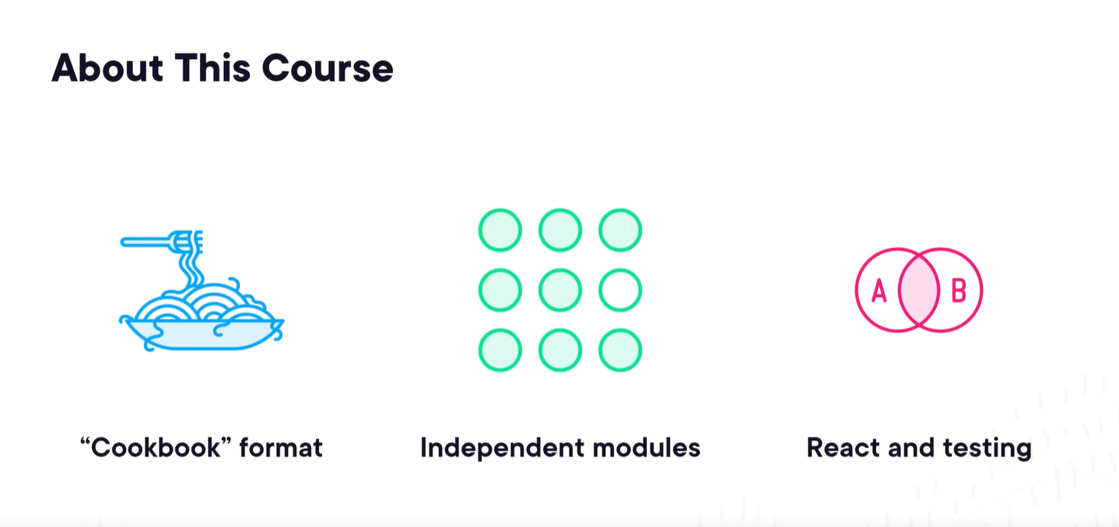

Slide 3
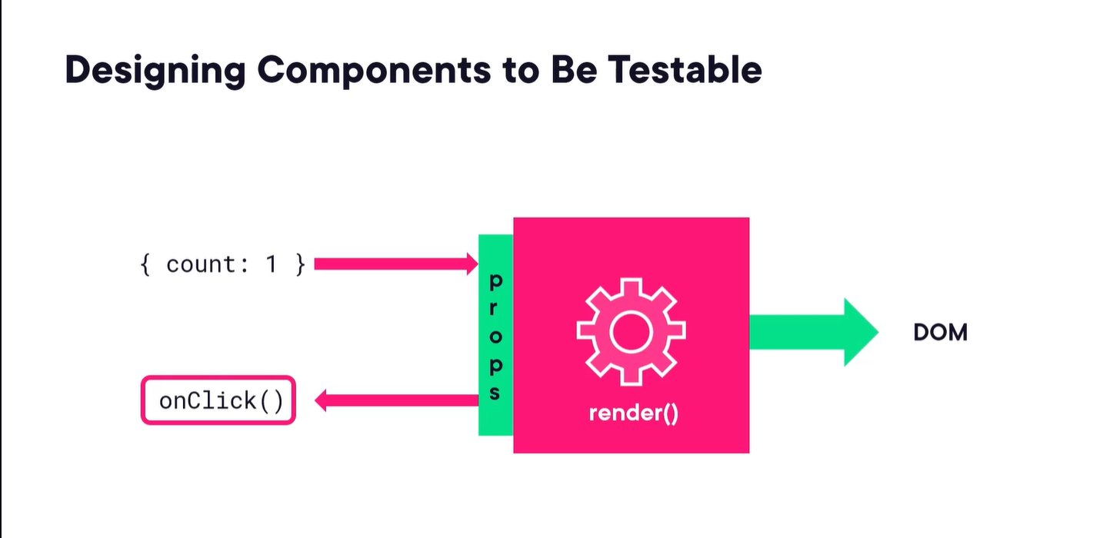

Slide 4
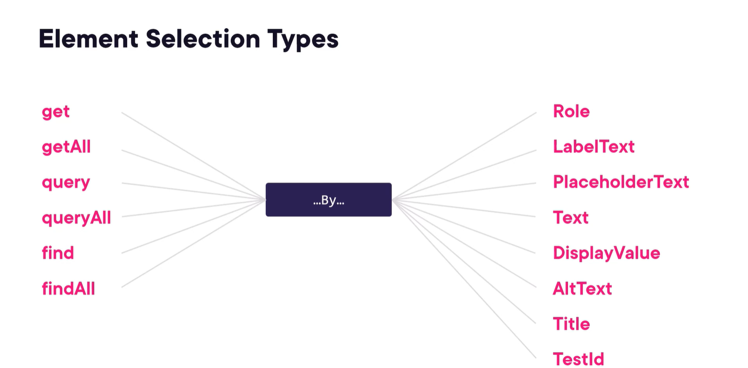

Slide 5
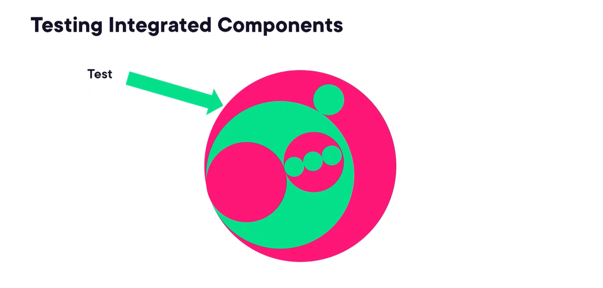
◀ Render <Counter start={1} /> and look for ‘1’ in the rendered result
const Counter = ({start}) => { return (
<div>{start}</div>
);
};

Slide 6
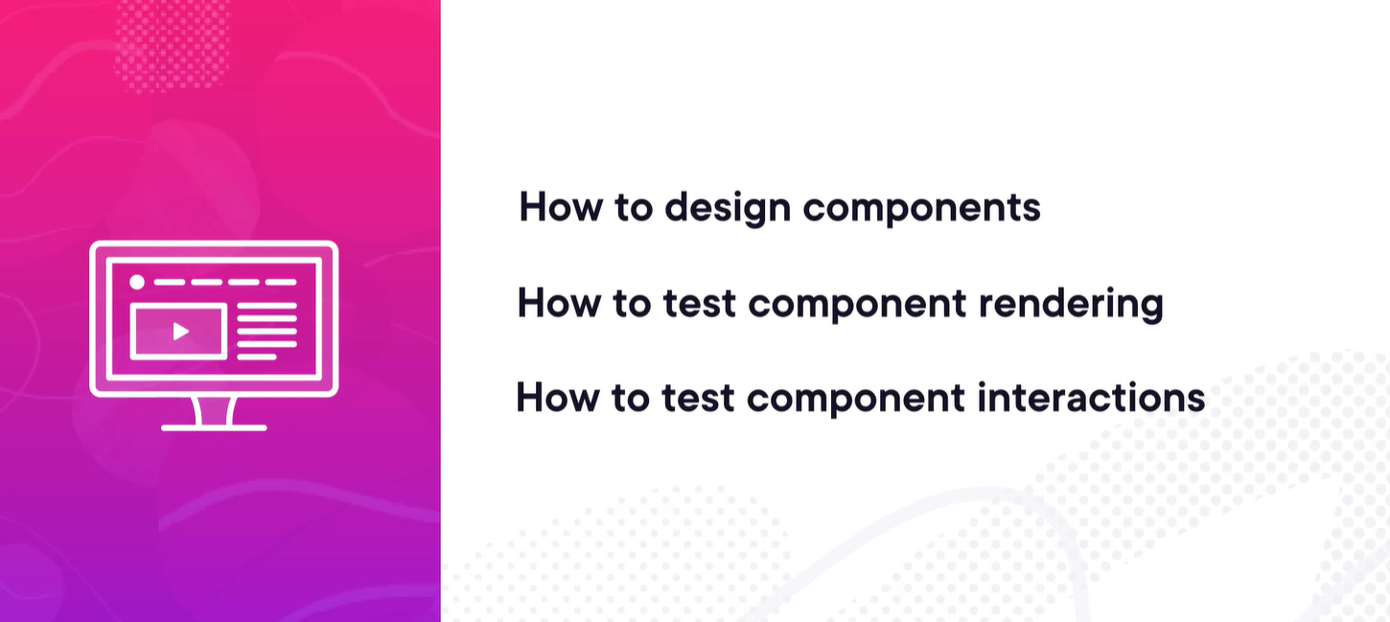
◀ Render Counter, simulate a click on the div, and assert that ‘onIncrement’ was called.

Slide 7
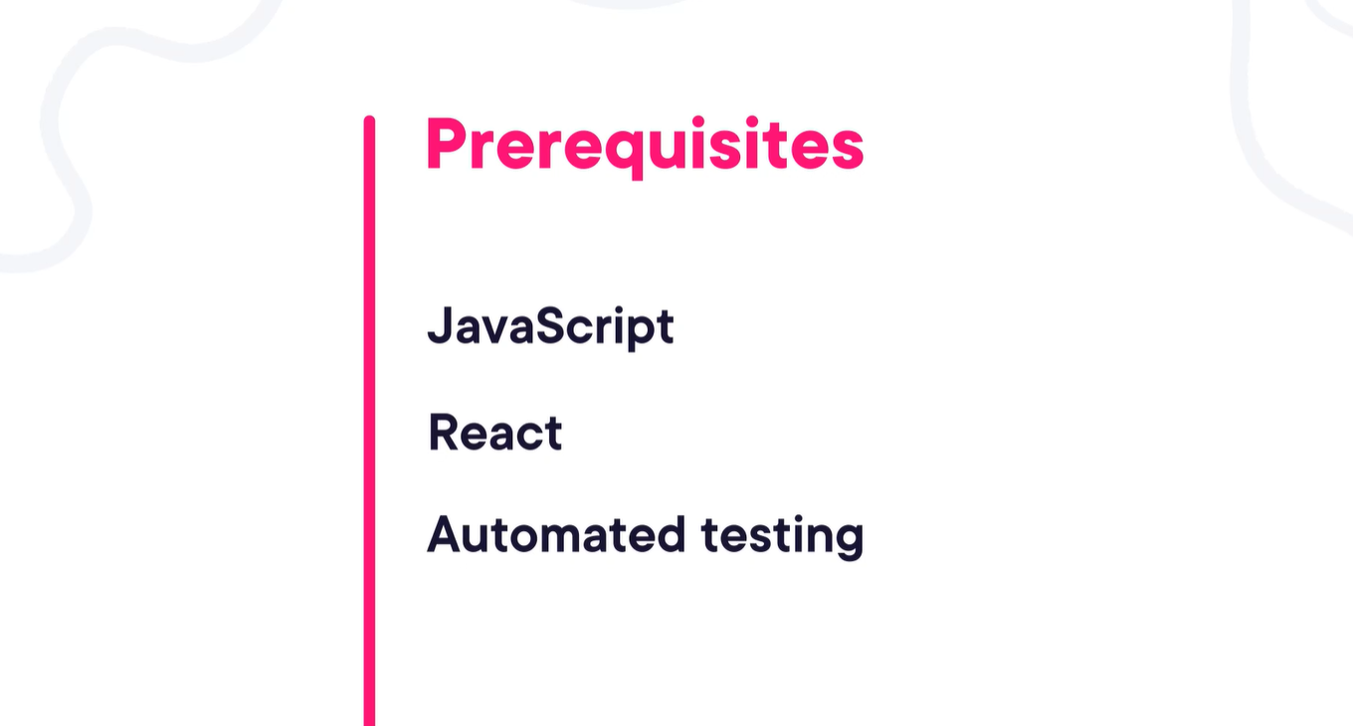
Creating a React Application With a Test

